Slide 1
Team 5 Conceptual Design
Dillon Williams, Nidhay Patel, Ryan Reed,
Michel Turpeau, Austin Sigg

Slide 2
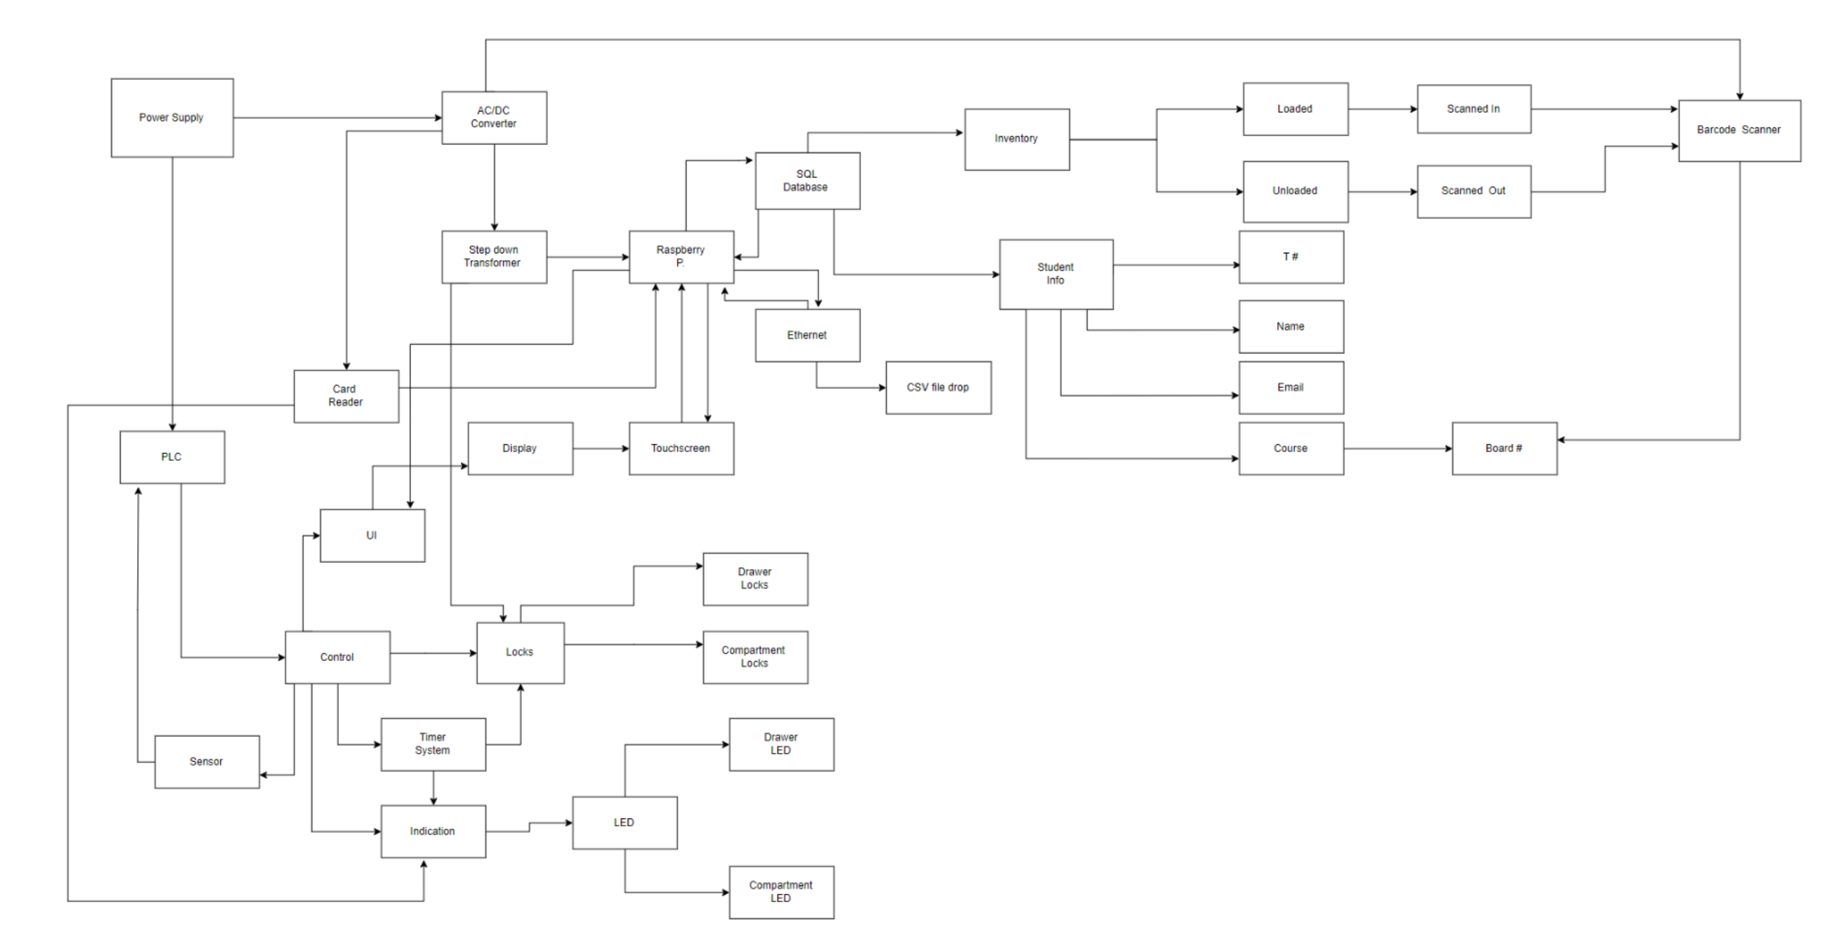

Slide 3
Dillon

Slide 4
Nidhay

Slide 5
Ryan

Slide 6
Mick

Slide 7
Sigg

